Slide 1

Bank Loan Prediction
Group Member
Clinton Idehen
Joey Z
Yichao Li
Simon Gomes

Slide 2

Could anyone guess how big the private loan sector in Australia?

Slide 3
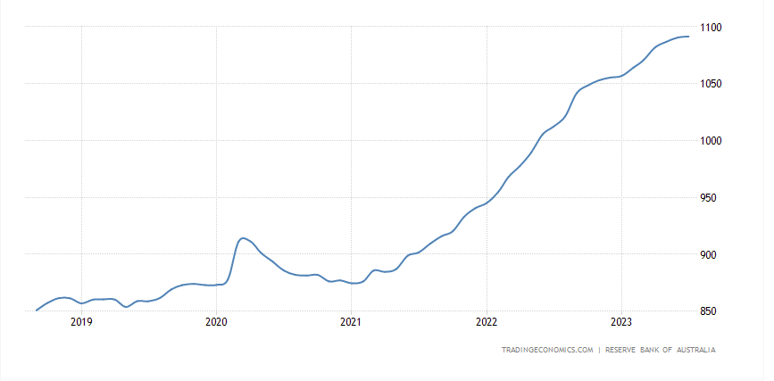
Loans to Private Sector in Australia increased to 1091.47 AUD Billion in July from 1090.51 AUD Billion in June of 2023.

Slide 4
Motivation
In today's rapidly evolving financial landscape, lending institutions face the challenge of making informed decisions while managing risks. One of the critical aspects of this process is predicting whether a loan applicant is likely to default on their loan or repay it as agreed. To address this challenge, financial institutions are increasingly turning to machine learning, a powerful tool that can analyze vast amounts of data to provide predictive insights.
In this presentation, we will explore into the fascinating world of machine learning and its applications in the banking sector. Specifically, we will focus on how machine learning algorithms can be employed to predict the likelihood of loan applicants defaulting on their loans. This topic is of utmost importance to banks and other financial institutions as it can help them mitigate risks, streamline the lending process, and ensure the sustainability of their operations.

Slide 5
Dataset
Project Objective
The project's objective was to predict the likelihood of a liability customer purchasing personal loans. This required building a model to predict which customers were most likely to accept personal loan offers based on their specific relationships with the bank across various features provided in the dataset.
Supervised Learning methods were utilized to determine the most suitable model for this task, with the options considered including Logistic Regression, K-Nearest Neighbors (KNN), and the Naive Bayes Algorithm.
The Universal Bank Loan Classification dataset is accessible to the public through Kaggle. It comprises 5,000 instances and encompasses 14 distinct attributes.
The dataset comprises customer demographic details such as age, income, and more, as well as information about the customer's interactions with the bank, including factors like mortgage and securities accounts. Additionally, it encompasses the customer's response to the previous personal loan campaign (Personal Loan).
Out of the 5000 customers analyzed, only 480, which is equivalent to 9.6% of the total, accepted the personal loan.

Slide 6





Programming Language

Slide 7
Machine Learning Process
Loan data from Kaggle (CSV file)
Data cleaning
Test data to find missing value
Exploratory Data Analysis
Data Preparation
Data Visualization
Compare the model
i)Logistic Regression
ii) K-Nearest Neighbors (KNN)
iii) Naive Bayes Algorigthm
Compare and find out the best model

Slide 8

Exploratory Data Analysis and Data Visualisation
By using Python, Leaflet, Tableau

Slide 9
Understanding Data frame
Nominal Variables :
ID - Customer ID
ZIP Code - Home Address ZIP code of the customer. This variable can also be ignored because we can not judge the customers based on their area or location.
Ordinal Categorical variables :
Family - Number of family member of the customer
Education - Education level of the customer. In our dataset it ranges from 1 to 3 which are Under Graduate, Graduate and Post Graduate respectively.
Interval Variables :
Age - Age of the customer
Experience - Years of experience of customer has
Income - Annual Income of the customer which is in dollars
CCAvg - Avg. spending on credit cards per month which in dollars.
Mortgage - Value of House Mortgage
Binary Categorical Variable :
CD Account - Does the customer have Certificate of Deposit Account with bank or not?
Security Account - Does the customer have Security Account with bank or not?
Online - Does the customer have Online banking facility with bank or not?
Credit Card - Does the customer have a credit card issued by Universal Bank or not?
Personal Loan - This our target variable which we have to predict. This indicates that the customer has token loan or not?

Slide 10
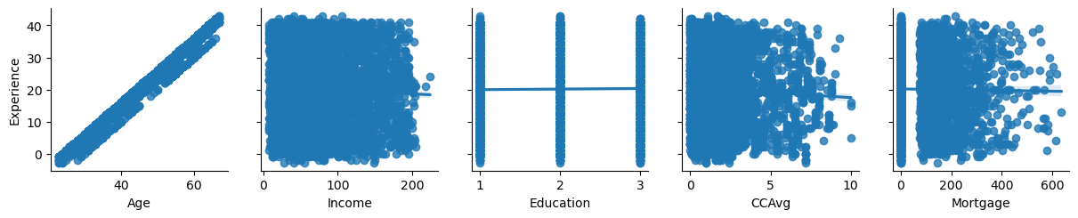
Association of Experience with other variables
Observation: By looking above plots we can see that 'Age' has very strong and positive association with 'Experience’. We are also considering 'Education' to fix the negative experience error. Because as we know experience relates to the education level.
Decision: We can replace each negative 'Experience' value with the median of positive 'Experience' associated with the particular 'Age' and 'Education' value.
**CCAvg - Avg. spending on credit cards per month which in dollars.
**Education - 1 = Undergraduate, 2= Graduate and 3= Postgraduate.

Slide 11
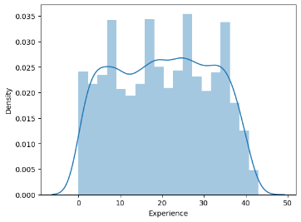
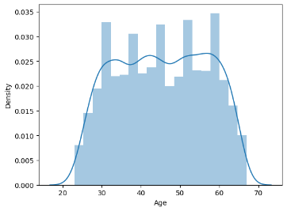
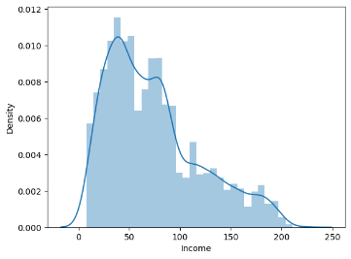
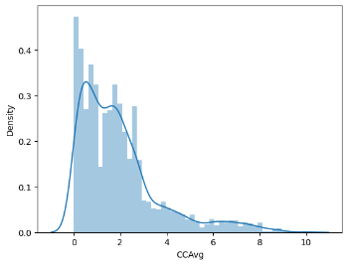
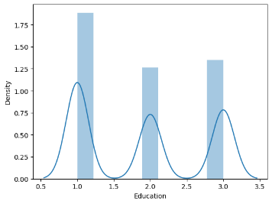
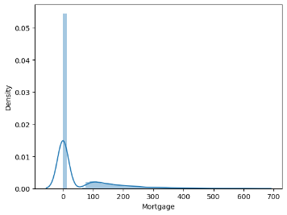
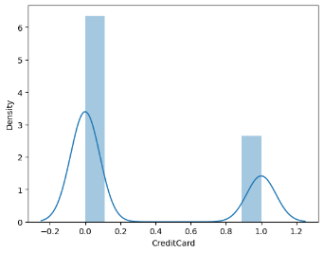
“Age” “Experience" column - normally distributed.
“Income” - distributions is right skewed distribution because the tail goes to the right
“CCAvg” - distributions is right skewed distribution because the tail goes to the right. Most of the customers monthly avg. spending on credit cards is between 1k to 2.5K. There are very few customers whose monthly avg. spending on credit card is more than 8k
“Education” - Undergrad level customers are more than the Graduate and Advanced/Professional customers
“Mortgage” - The above distribution is right skewed distribution because the tail goes to the right. Most of the customers do not have mortgage.
“Credit cards” - Number of customers without Credit Card is almost double than the number of customers with Credit Card.
**CCAvg - Avg. spending on credit cards per month which in dollars.

Slide 12
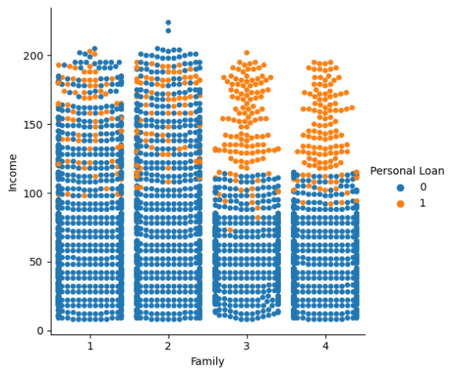
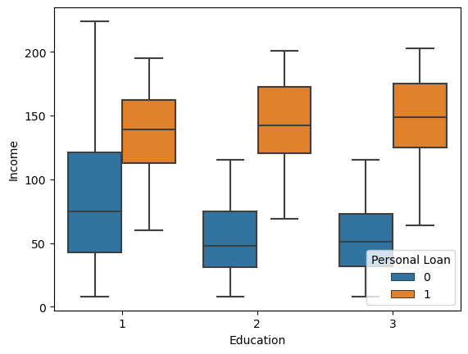
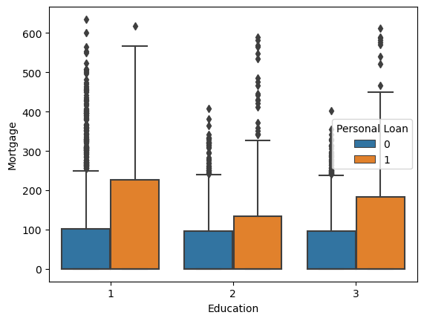
From above we can say that customers with undergraduate level of education and family greater than 3 are good customers who took loan. Customer who took loan have same income range irrespective of education level. Education of Graduate and above have more chance to take loan.
From the above box plot we can see that customers whose education level is 1 and did not take loan has higher mortgage than customers who take loan of same education level. Customers whose education level is 2and 3 and did not take loan has lesser mortgage than customers who take loan of same education level.
Customers who have family size 3 or greater with higher income between 100k to 200k are more likely to take loan.

Slide 13
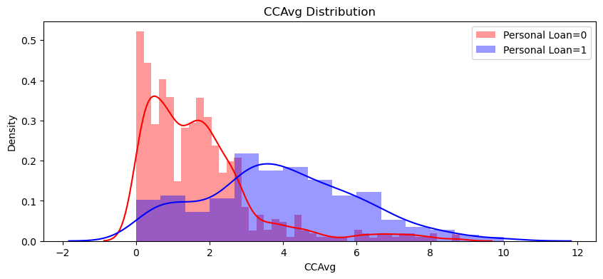
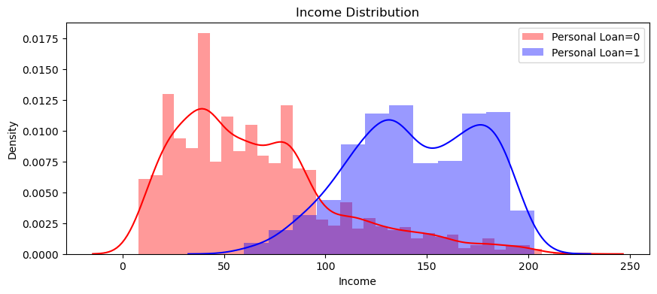
Customers who have taken personal loan have higher credit card average than those who did not take loan. So high credit card average seems to be good predictor of whether or not a customer will take a personal loan.
Customers who have taken personal loan have income than those who did not take. So high income seems to be good predictor of whether or not a customer will take a personal loan.
**CCAvg - Avg. spending on credit cards per month which in dollars.

Slide 14
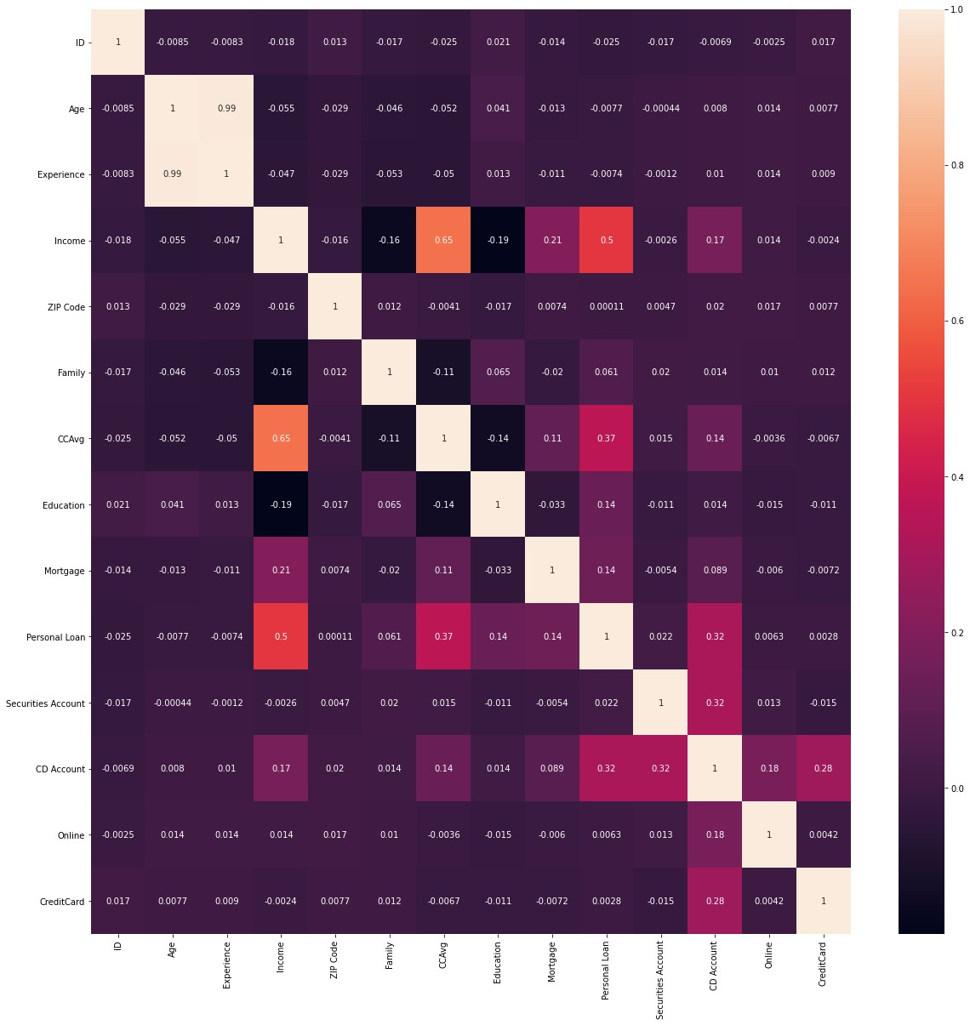
Heat map
Age and Experience are highly correlated, and the correlation is almost 1.
'Income' and 'CCAvg' is moderately correlated.
Personal Loan has maximum correlation with 'Income', 'CCAvg', 'CD Account', 'Mortgage', and 'Education'.
We can see in above heat map there is association of 'CD Account' with 'Credit Card', 'Securities Account', 'Online', 'CCAvg' and 'Income'.
'Mortgage' has moderate correlation with 'Income' which is about 12%.
'Income' influences 'CCAvg', 'Personal Loan', 'CD Account' and 'Mortgage'.
**CCAvg - Avg. spending on credit cards per month which in dollars.
**CD Account - Does the customer have Certificate of Deposit

Slide 15
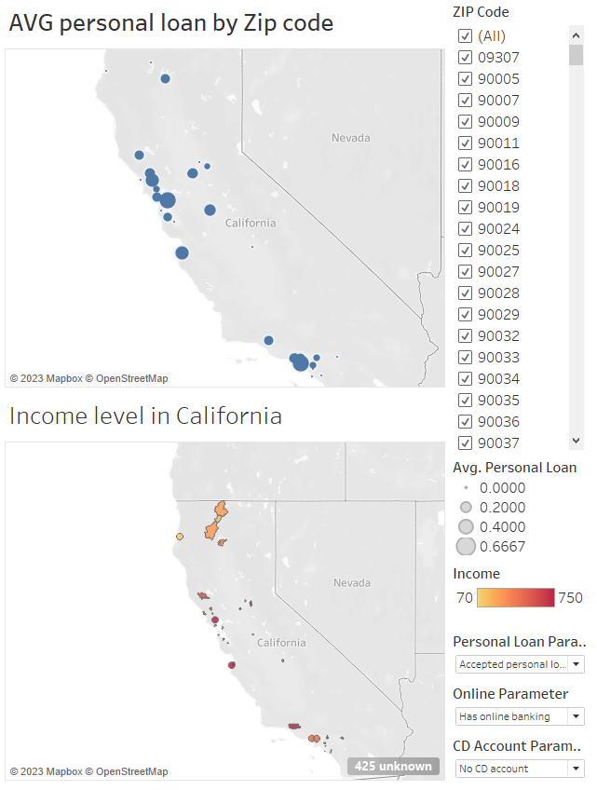
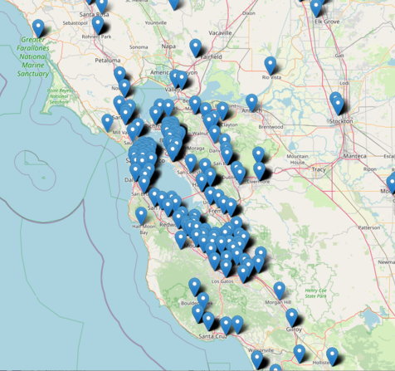
Leaflet
Tableau

Slide 16
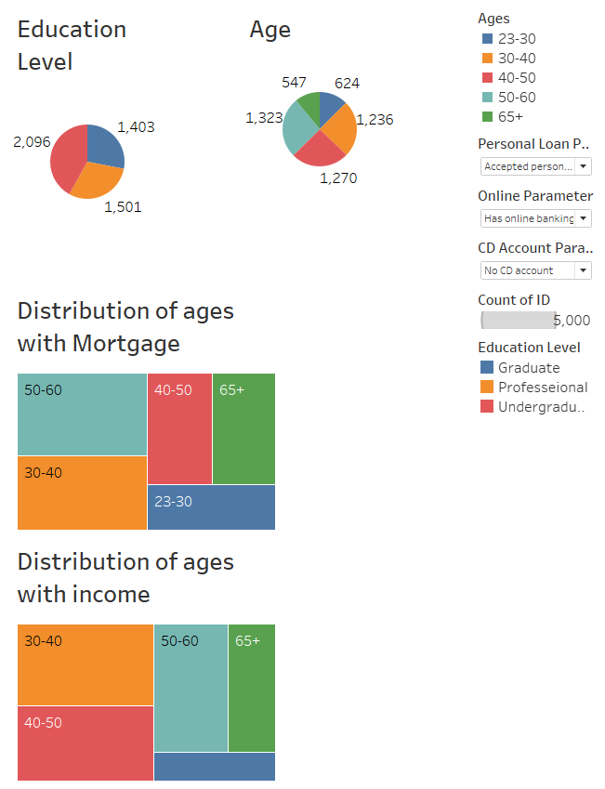
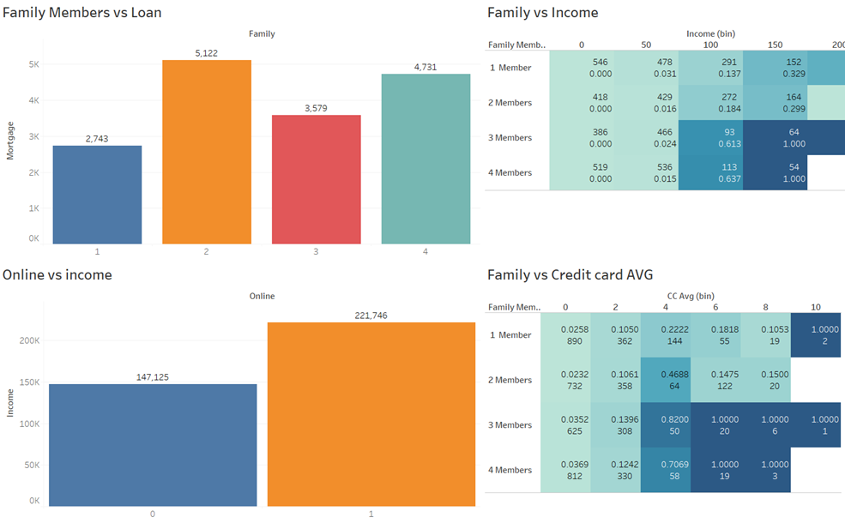
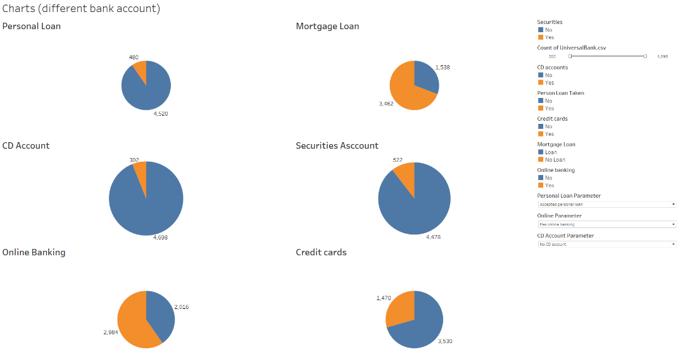
Tableau

Slide 17

Model Preparation and Logistic Regression

Slide 18

Model Building
As we have seen above 'ID' and 'ZIP Code' are not relevant for our model building so we will drop it.
'Age' and 'Experience' are highly correlated so we will build our model with 'Experience' and without 'Experience' after that we will compare the accuracy which will lead us to the conclusion that with 'Experience' or without 'Experience' which model is better for prediction.

Slide 19
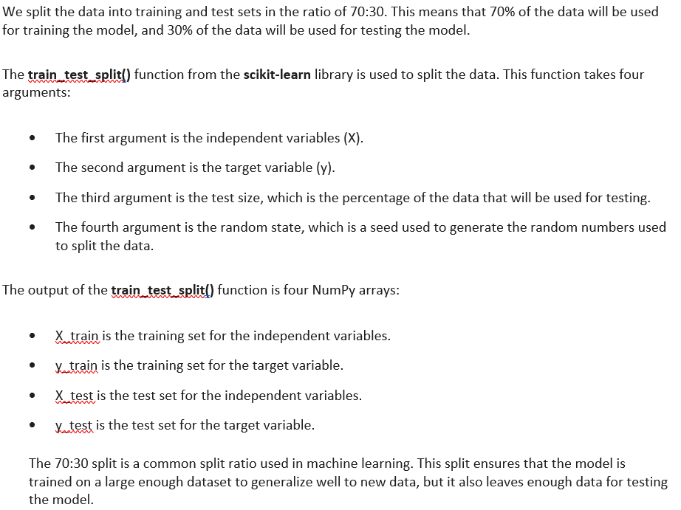
Split the dataset

Slide 20
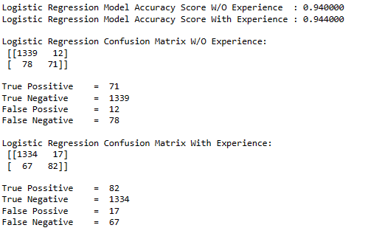
Logistic Regression
From the above accuracy results we see that accuracy is higher with 'Experience' (94.40 %) than without 'Experience' (94.00%).
Also, from the above confusion metrices we can see that the prediction of customers who don't accept loan and the customers who accept loan is better with 'Experience'.
Type 1 (False Positive) and Type 2(False Negative) errors is less with experience.
Hence, we can improve the accuracy by scaling the attributes.

Slide 21

K-Nearest Model

Slide 22
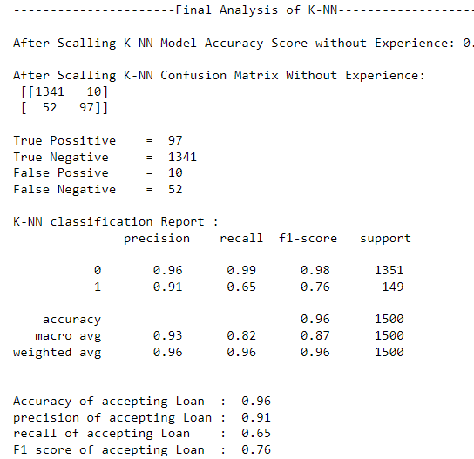
K-Nearest Model
K-NN, or K-Nearest Neighbors, is a supervised machine learning algorithm used for both classification and regression tasks.
Ran the KNN with number of odd neighbours' ranges from 1 to 20 and will find the optimal number of neighbours using the Mis classification error (K = 3)
Model building and testing
Experience vs. no experience

Slide 23

Naïve Bayes Model

Slide 24
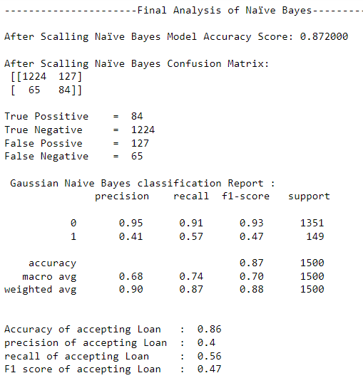
Naïve Bayes Model
The Naïve Bayes model is a popular and simple machine learning algorithm for classification tasks, particularly in text and natural language processing applications.
It's based on the Bayes' theorem, which is a fundamental probability theorem.
Independence assumption
Model training

Slide 25
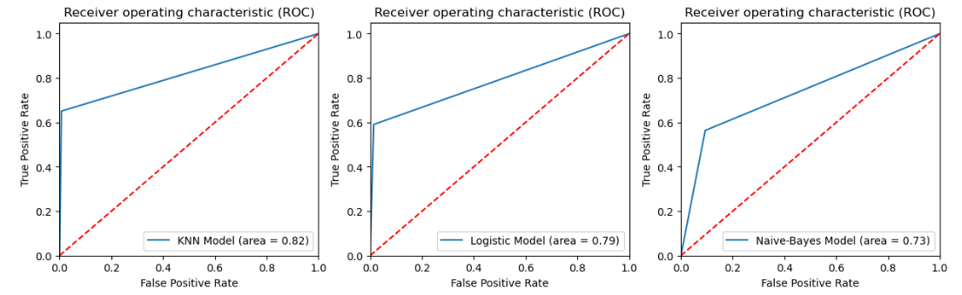
Model evaluation
K-Nearest Neighbors:
True Positive = 97
True Negative = 1341
False Positive = 10
False Negative = 52
Accuracy: 96%
Logistic Regression:
True Positive = 88
True Negative = 1333
False Positive = 18
False Negative = 61
Accuracy: 95%
Naive Bayes:
True Positive = 84
True Negative = 1224
False Positive = 127
False Negative = 65
Accuracy: 87%

Slide 26

Conclusion and predict the best model

Slide 27

Conclusion to Predict the best Model
Based on the information provided earlier, it is evident that when using scaled data, the k-Nearest Neighbours Algorithm achieves the highest accuracy, reaching 96%.
Furthermore, the K-Nearest Neighbours model exhibits the lowest occurrences of Type I (False Positive) and Type II (False Negative) errors when compared to other models.
The area under the ROC curve for the K-Nearest Neighbours model is 0.82, which is closer to 1.
Therefore, among the three algorithms applied to the dataset in question, the K-Nearest Neighbours model appears to be the most suitable choice for predicting which customers are likely to accept the personal loan.

Slide 28

Thank you

